Slide 1

Data Science
IICT Lecture 11
FAST NUCES, Lahore

Slide 2
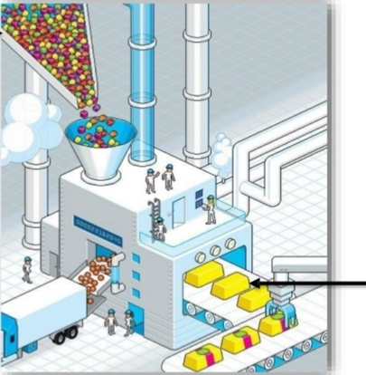
What is Big Data?
Lots of Data (Terabytes or Petabytes)
Enterprises/Companies achieve related amount of information and business insights
FAST NUCES, Lahore

Slide 3
Big Data Scenarios
FAST NUCES, Lahore

Slide 4
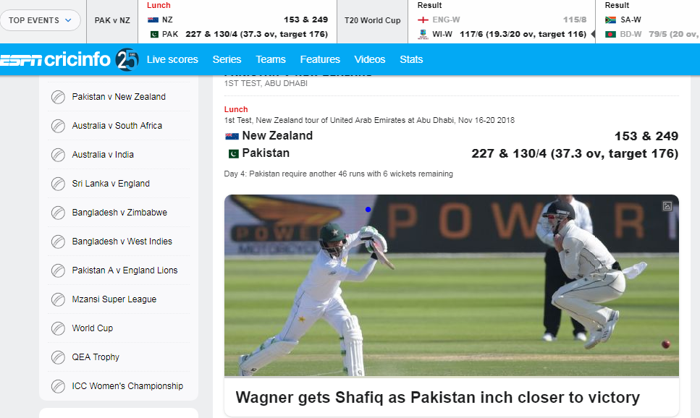
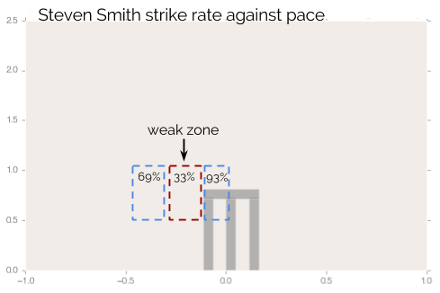

CrickInfo: Sports
Ticketing companies used big data to track ticket Sales
Sports Teams are using data for tracking team strategies
FAST NUCES, Lahore

Slide 5

Hospital Care
Hospitals are analyzing medical data and patient records to predict those patients that are likely to seek readmission within a few months of discharge.
Medical diagnostics company analyzes previous existing data to develop non-intrusive test for predicting coronary artery diseases, lung cancers, brain tumors and so on
FAST NUCES, Lahore

Slide 6
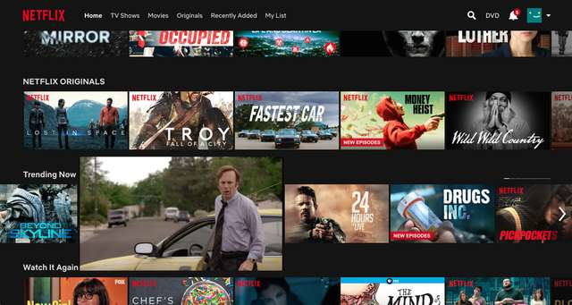
NetFlix
Netflix, Inc. is an American media-services provider headquartered in Los Gatos, California
Uses 1 Petabyte to store the videos for streaming
(According to the Motion Picture Association of America, the number fluctuates, but the average seems to be around 600 movies created in the US every year)
1 Petabyte of average MP3-Encoded songs (for mobile, roughly one megabyte per minute), would require 2000 years to play
Movies recommendation

Slide 7
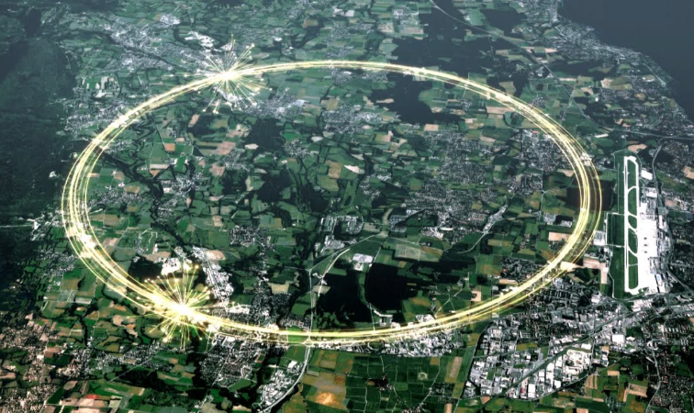
The Large Hadron Collider
(CERN Franco-Swiss)
The Large Hadron Collider (LHC) is the world's largest and most powerful particle collider and the largest machine in the world.
The LHC consists of a 27-kilometre ring of superconducting magnets with a number of accelerating structures to boost the energy of the particles along the way.
The experiments in the LHC produce about 15 petaytes of data per year, which are distributed over the Worldwide LHC Computing Grid
FAST NUCES, Lahore
Notes:
European Organization for Nuclear Research

Slide 8
And many more
Predict Traffic given a time and location
Facebook’s friends suggestions, Image automatic annotations….etc.
Real time soccer Analytics
…
FAST NUCES, Lahore

Slide 9
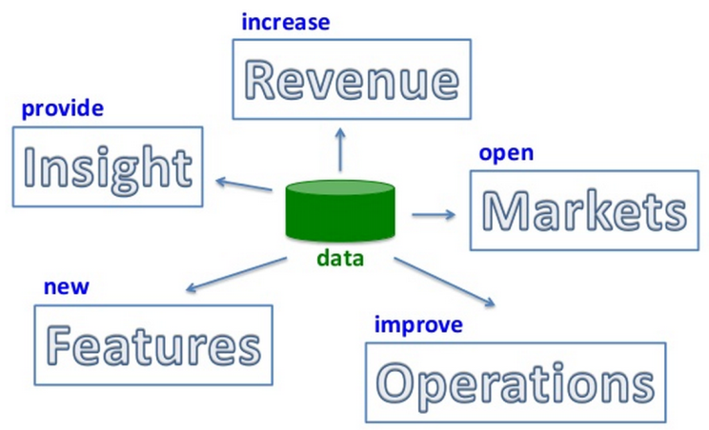
What can Data do?
FAST NUCES, Lahore

Slide 10
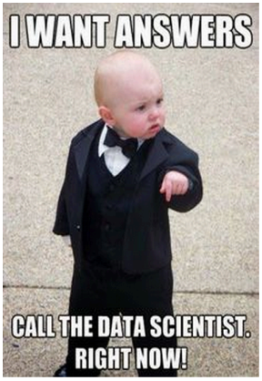
FAST NUCES, Lahore

Slide 11
What is Data Science?
Data science is a multifaceted field used to gain insights from complex data. [MITx]
Data science is an interdisciplinary field that uses scientific methods, processes, algorithms and systems to extract knowledge and insights from data in various forms, both structured and unstructured. [Wikipedia]
Data science is the study of where information comes from, what it represents and how it can be turned into a valuable resource in the creation of business and IT strategies
FAST NUCES, Lahore

Slide 12
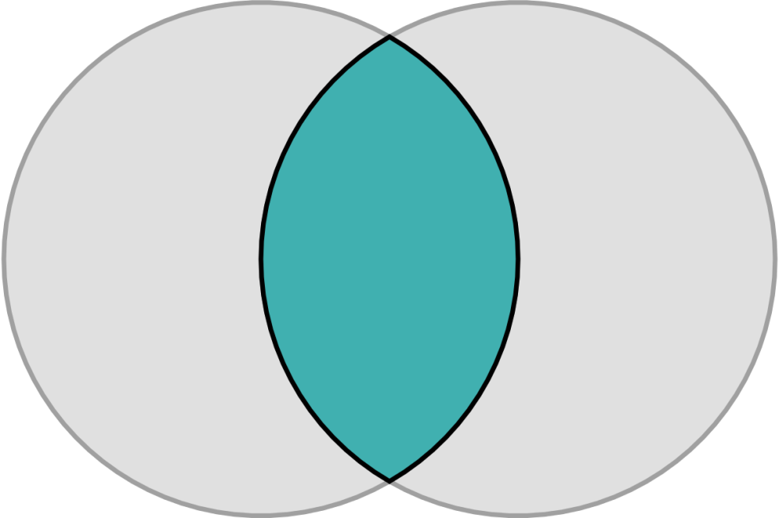
What can Data Science do for business?
Business
Data Science! Extracting useful information and knowledge from large volumes of data in order to improve business decision-making or providing the business insights to make data-driven decisions
Data
FAST NUCES, Lahore

Slide 13
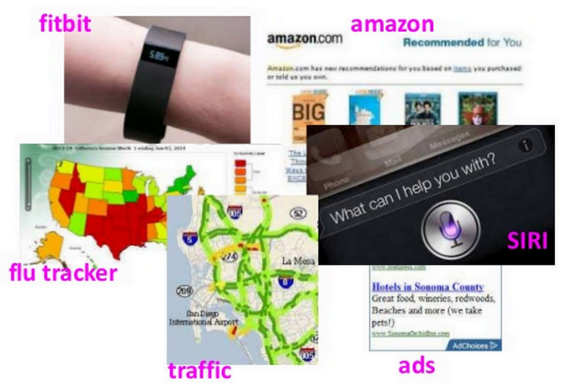

Other applications of Data Science
FAST NUCES, Lahore

Slide 14
What Data Science Involve?
Math and Statistics Knowledge
Machine Learning
Data Analysis
Moreover, It employs techniques and theories drawn from many fields within the context of mathematics, statistics, information science, and computer science.
FAST NUCES, Lahore

Slide 15
Machine Learning
Machine learning focuses on the development of computer programs that can access data and use it to learn for themselves.
Machine Learning programs are also designed to learn and improve over time when exposed to new data
FAST NUCES, Lahore

Slide 16
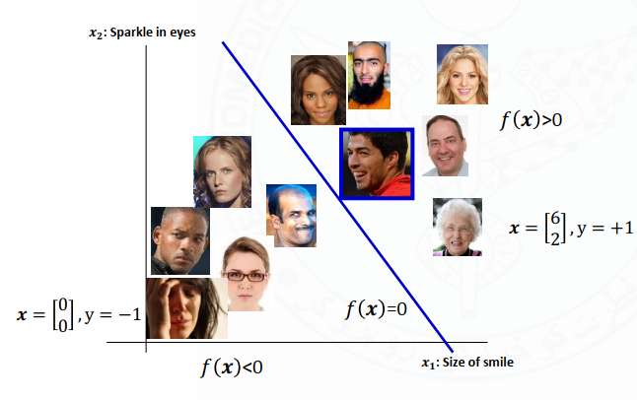
Supervised Learning
Definition:
  Where a program is “trained” on a pre-defined dataset. Based off its training data the program can make accurate decisions when given new data.
Business Application
  Classifying Twitter sentiments
  Fake product review detection
  User sentiment in reviews.

Slide 17
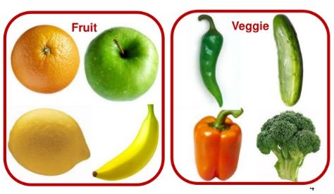
Unsupervised Learning
Definition
  Where a program, given a dataset, can automatically find patterns and relationships within the dataset.
  Clustering or grouping of like data.
Business Application
  Customer segmentation
  Understanding users and Behaviors
  Classifying unknown and predefined images into categories

Slide 18
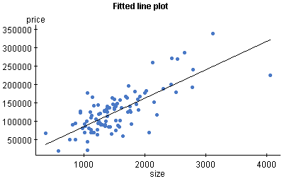
Regression
Sub-category of Supervised Learning
Regression is a type of algorithm that predicts a continuous values
Plot prices with relative to increase in area
FAST NUCES, Lahore

Slide 19
Activity 1
Go to following link
  http://www.shodor.org/interactivate/activities/Regression/
  Plot the following data (next slide)
  Click on display line of best fit
FAST NUCES, Lahore

Slide 20
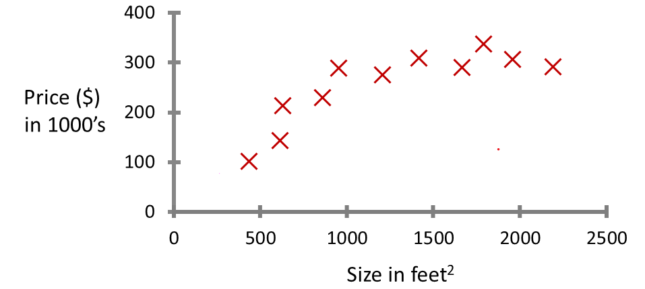
FAST NUCES, Lahore

Slide 21
Activity 2
Go to following link
  https://playground.tensorflow.org
  Click on first option under “DATA”
  Make sure HIDDEN LAYERS value 2 (by using + and – sign)
  Make sure at first layer value is 4 neurons and at second layer value is 2 neurons
  Click on play button and wait for sometime
  Repeat for 3rd option under “DATA”
FAST NUCES, Lahore

Slide 22
End of the Lecture
FAST NUCES, Lahore

